Slide 1
PSA Code Sprint 2023
059 CRAWL
Foo Chuan Shao
Raymond Harrison
Sim Wang Lin
Sean Ang

Slide 2
Table of contents
01
02
03
04
Background
Problem Statement
Value Add
App Demo

Slide 3
01
Background

Slide 4
Theme
‘Towards a highly resilient Port Ecosystem’
Notes:
Story by raymond

Slide 5
Pain Points
Demand Forecasting
Shipping schedules, trade fluctuations, and seasonal variations make predicting future demand difficult
Managing Berth Supply
There are limited berths to allocate for incoming vessels and cargo
Optimising Allocation of Resources
Which cranes and handling equipment should go where for smoother operations

Slide 6
02
Problem Statement

Slide 7
Theme in Focus
‘How can digital solutions powered by data and AI optimize demand and supply to increase resilience of the port amidst global disruptions and risks?’

Slide 8
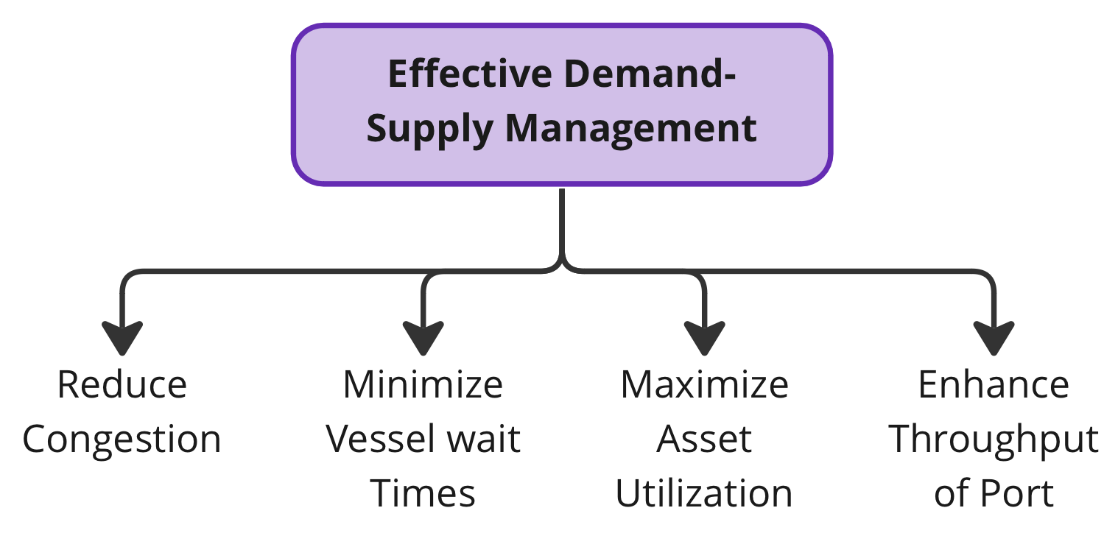
Our Goal

Slide 9
03
Value Add

Slide 10
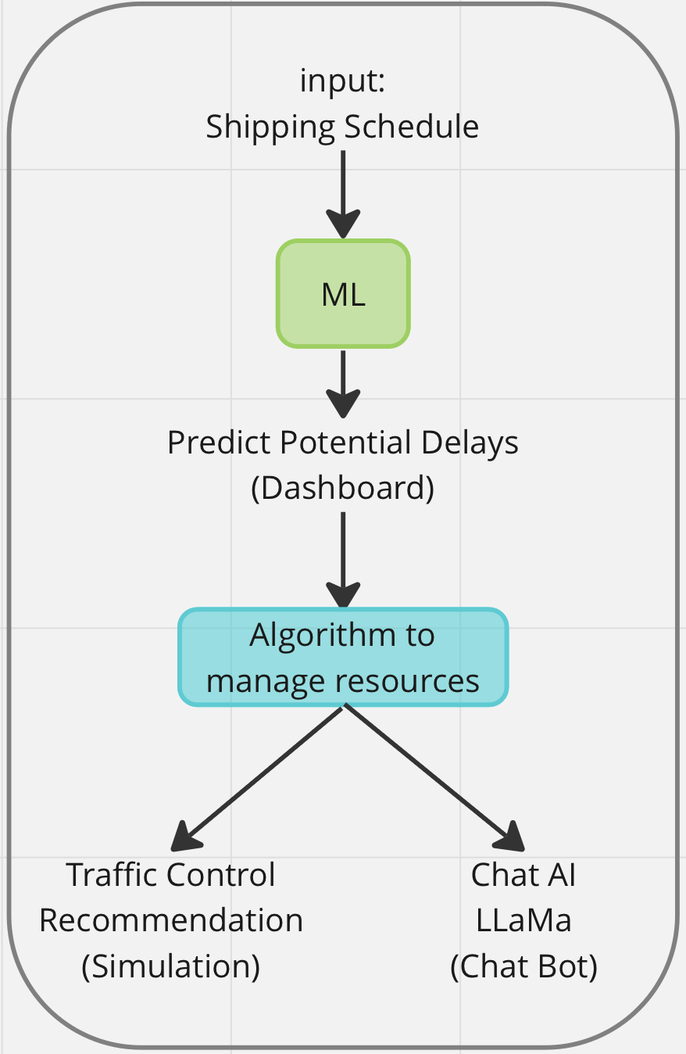
Our App
is a user-friendly and all-encompassing application that accepts ship schedules, forecast potential delays and optimizes port resources.

Slide 11
App Features
Machine Learning
GenAI
Predict delayed vessels, and their expected departure time
A quick and Interactive way to understand your data
Simulation
Dashboard
Visual aids suggest the most efficient way to dock ships
View all ship details in berthing order

Slide 12
04
App demo

Slide 13
Thank You
Do you have any questions?
https://github.com/59CRAWL
Please, keep this slide for the attribution

Slide 14
04
Thanks, any questions?
Notes:
Old presentation slide link: https://docs.google.com/presentation/d/14-c8BqwxgT_wmx7lv32CsGZ9QGMpWoFIrJKLx3TZb4M/edit#slide=id.gcd8a80d6bc_0_0

Slide 15
Timeline
Step 1
Step 2
Step 3
Step 4
Venus is the second planet from the Sun
Saturn is a gas giant and has several rings
Mars is a red planet and It’s a cold planet
Mercury is the closest planet to the Sun
Step 5
Step 6
Step 7
Step 8
Venus is the second planet from the Sun
Saturn is a gas giant and has several rings
Despite being red, Mars is a cold planet
Neptune is very far away from us

Slide 16
Organizational chart
The Sun
CEO
Jupiter
Department Head
Neptune
Department Head
Saturn
Manager
Earth
Manager
Venus
Manager
Mars
Manager
Moon
Employee
Mercury
Employee
Titan
Employee
Triton
Employee
Callisto
Employee

Slide 17
Roadmap infographic
Initiative | Objective | Ja | Fe | Ma | Ap | Ma | Ju | Ju | Au | Se | Oc | No | De
Neptune is big | Neptune is an ice giant and the farthest planet of them all
Earth has life | Earth is the beautiful planet on which humans live
Mars is very cold | Despite being red, Mars is actually a cold planet
Jupiter is a gas giant | Jupiter is the biggest planet in the Solar System
Saturn has rings | Saturn is a gas giant and has several rings
Mercury is small | Mercury is the closest planet to the Sun and very small

Slide 18



Photo showcase
You can replace the images on the screen with your own work. Just right-click on them and select “Replace image”

Slide 19
Thanks
Do you have any questions?
youremail@freepik.com
+91 620 421 838
yourwebsite.com
Please, keep this slide for the attribution

Slide 20
Alternative resources
Here’s an assortment of alternative resources whose style fits the one of this template:
Vectors:
Business people illustration concept

Slide 21
Resources
Did you like the resources on this template? Get them for free at our other websites:
Vectors:
Organic flat business people collection
Business people flat design
Hand drawn innovation concept with rocket
Photos:
Businessman working laptop
Person taking part business event
Smiley men discussing about project work
Different people brainstorming work meeting

Slide 22
Instructions for use
If you have a free account, in order to use this template, you must credit Slidesgo by keeping the Thanks slide. Please refer to the next slide to read the instructions for premium users.
As a Free user, you are allowed to:
Modify this template.
Use it for both personal and commercial projects.
You are not allowed to:
Sublicense, sell or rent any of Slidesgo Content (or a modified version of Slidesgo Content).
Distribute Slidesgo Content unless it has been expressly authorized by Slidesgo.
Include Slidesgo Content in an online or offline database or file.
Offer Slidesgo templates (or modified versions of Slidesgo templates) for download.
Acquire the copyright of Slidesgo Content.
For more information about editing slides, please read our FAQs or visit our blog:
https://slidesgo.com/faqs and https://slidesgo.com/slidesgo-school

Slide 23
Instructions for use (premium users)
As a Premium user, you can use this template without attributing Slidesgo or keeping the "Thanks" slide.
You are allowed to:
Modify this template.
Use it for both personal and commercial purposes.
Hide or delete the “Thanks” slide and the mention to Slidesgo in the credits.
Share this template in an editable format with people who are not part of your team.
You are not allowed to:
Sublicense, sell or rent this Slidesgo Template (or a modified version of this Slidesgo Template).
Distribute this Slidesgo Template (or a modified version of this Slidesgo Template) or include it in a database or in any other product or service that offers downloadable images, icons or presentations that may be subject to distribution or resale.
Use any of the elements that are part of this Slidesgo Template in an isolated and separated way from this Template.
Register any of the elements that are part of this template as a trademark or logo, or register it as a work in an intellectual property registry or similar.
For more information about editing slides, please read our FAQs or visit our blog:
https://slidesgo.com/faqs and https://slidesgo.com/slidesgo-school

Slide 24
Fonts & colors used
This presentation has been made using the following fonts:
Montserrat
(https://fonts.google.com/specimen/Montserrat)
Open Sans
(https://fonts.google.com/specimen/Open+Sans)
#452272
#fafafa
#5a45a0
#ffc63e
#d9bbfc
#ebae39
#937cf7
#dcdcff

Slide 25





Storyset
Create your Story with our illustrated concepts. Choose the style you like the most, edit its colors, pick the background and layers you want to show and bring them to life with the animator panel! It will boost your presentation. Check out how it works.
Pana
Amico
Bro
Rafiki
Cuate

Slide 26
Use our editable graphic resources...
You can easily resize these resources without losing quality. To change the color, just ungroup the resource and click on the object you want to change. Then, click on the paint bucket and select the color you want. Group the resource again when you’re done. You can also look for more infographics on Slidesgo.

Slide 29
JANUARY
FEBRUARY
MARCH
APRIL
MAY
JUNE
PHASE 1
Task 1
Task 2
PHASE 2
Task 1
Task 2
JANUARY
FEBRUARY
MARCH
APRIL
PHASE 1
Task 1
Task 2

Slide 32
...and our sets of editable icons
You can resize these icons without losing quality.
You can change the stroke and fill color; just select the icon and click on the paint bucket/pen.
In Google Slides, you can also use Flaticon’s extension, allowing you to customize and add even more icons.

Slide 33
Educational Icons
Medical Icons

Slide 34
Business Icons
Teamwork Icons

Slide 35
Help & Support Icons
Avatar Icons

Slide 36
Creative Process Icons
Performing Arts Icons

Slide 37
Nature Icons

Slide 38
SEO & Marketing Icons

Slide 39


